Slide 1
Weekly Progress
23 Juni – 30 Juni 2020

Slide 2
Teknologi yang digunakan:
Flutter
Firebase
Dart Programming Language
Adobe XD
Adobe Illustrator
Photoshop
MidTrans
Github
C++
Adobe Indesign
Visual Studio Code

Slide 3
Developing App
Visual Studio Code
Dart
C++
Github

Slide 4
Flutter
UI Design ( Native Performance )

Slide 5
Firebase
Cloud Firestore
Firebase Machine Learning & Prediction
Cloud Function
Authentication
Hosting
Cloud Storage
Realtime Database
Crashlytics
Performance Monitoring
Test Lab
App Distribution ( Fix / Beta )
In-App Messaging
A/B Testing
Cloud Messaging

Slide 6
Design & Prototyping
Adobe XD
Adobe Indesign
Adobe illustrator
Adobe Photoshop

Slide 7
Payment Gateway
Midtrans

Slide 8
Cost Production:
Open source:
Visual Studio Code
Dart
C++
Github
Adobe XD
Flutter

Slide 9
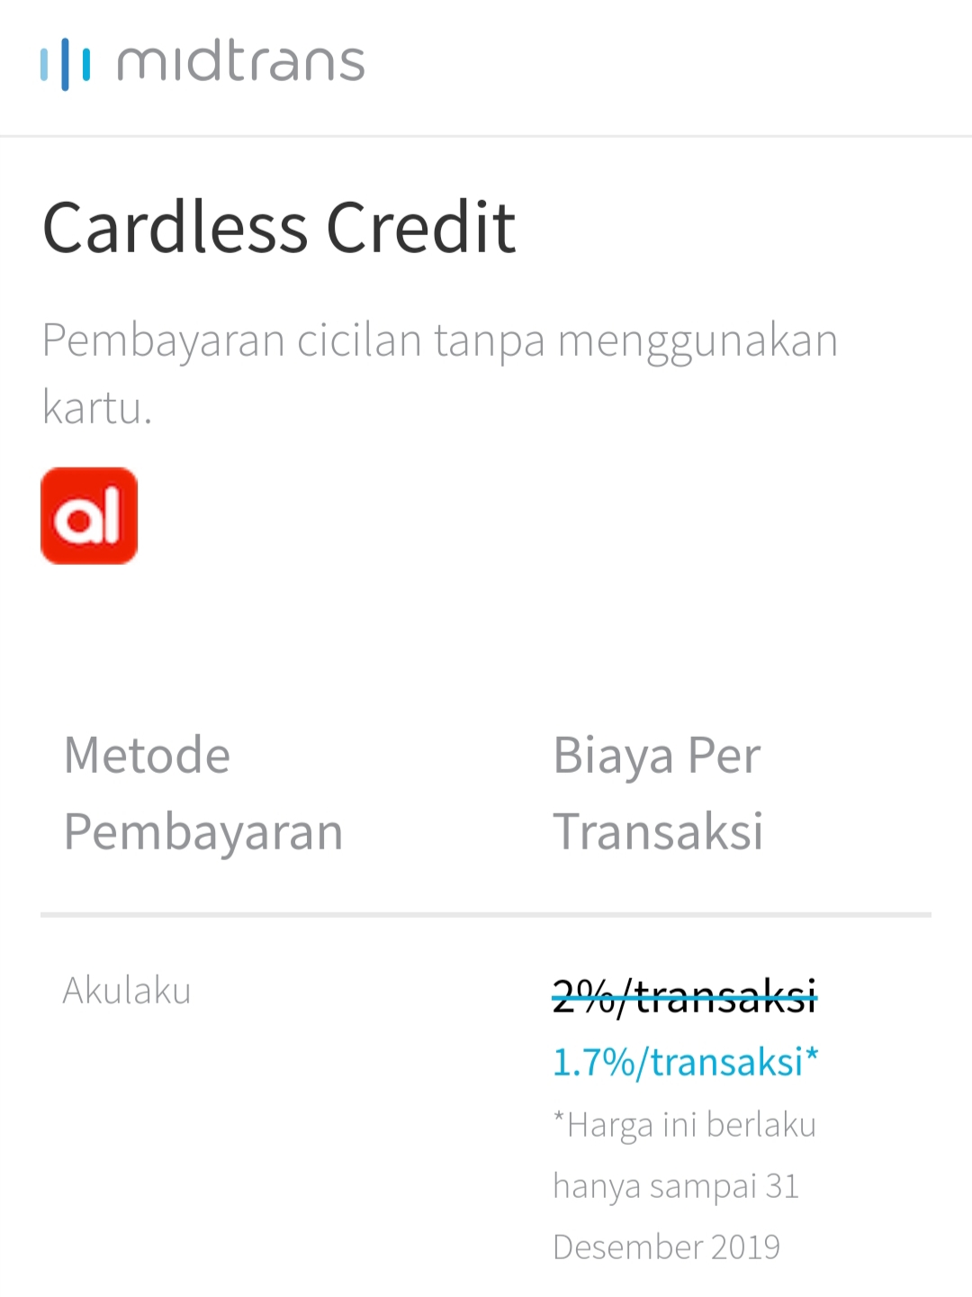
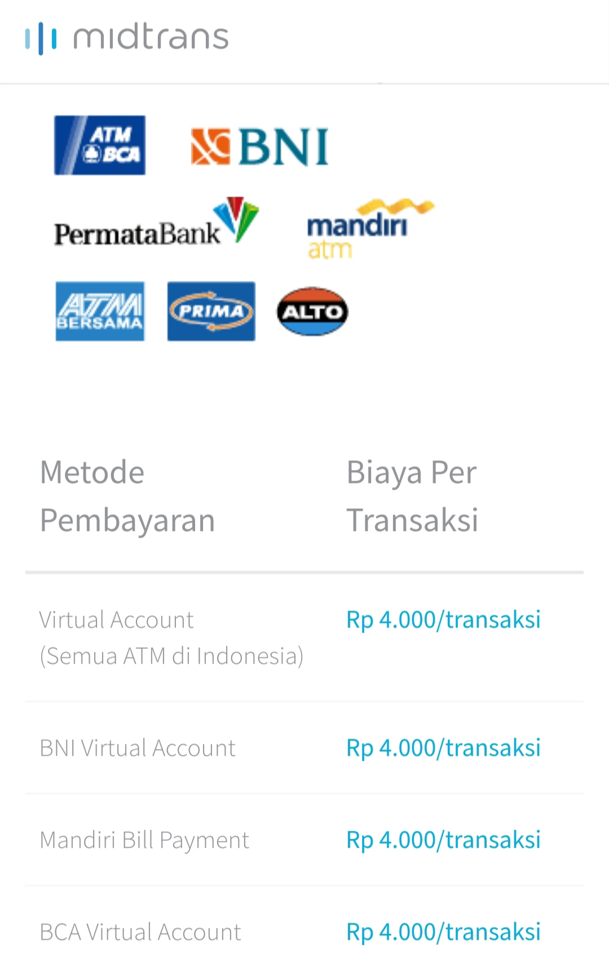
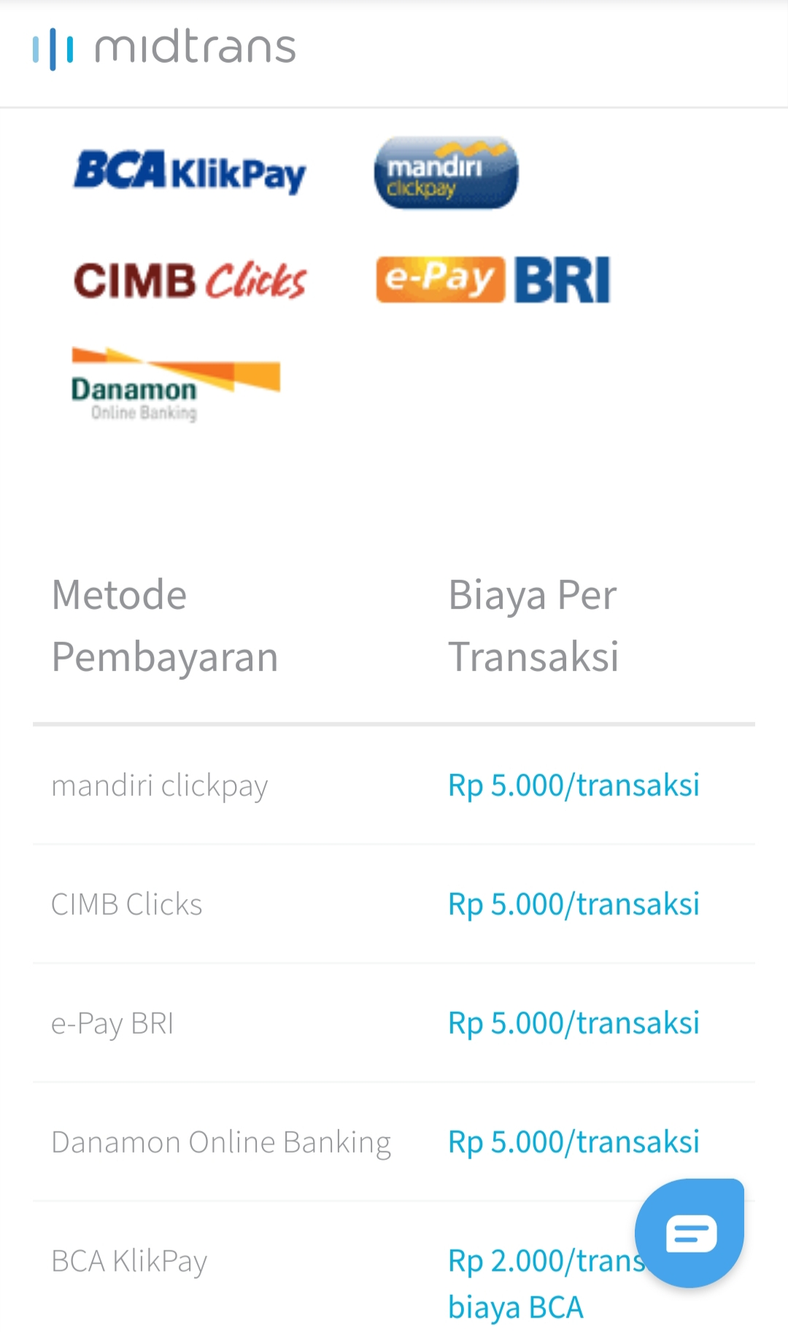
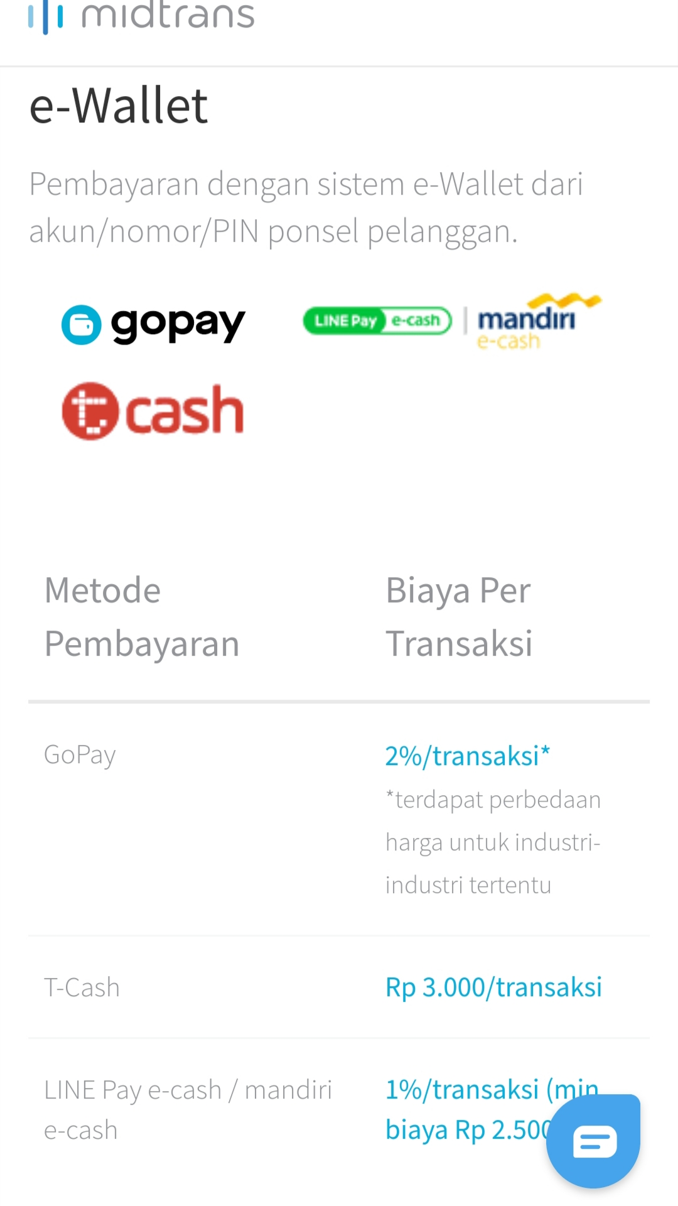
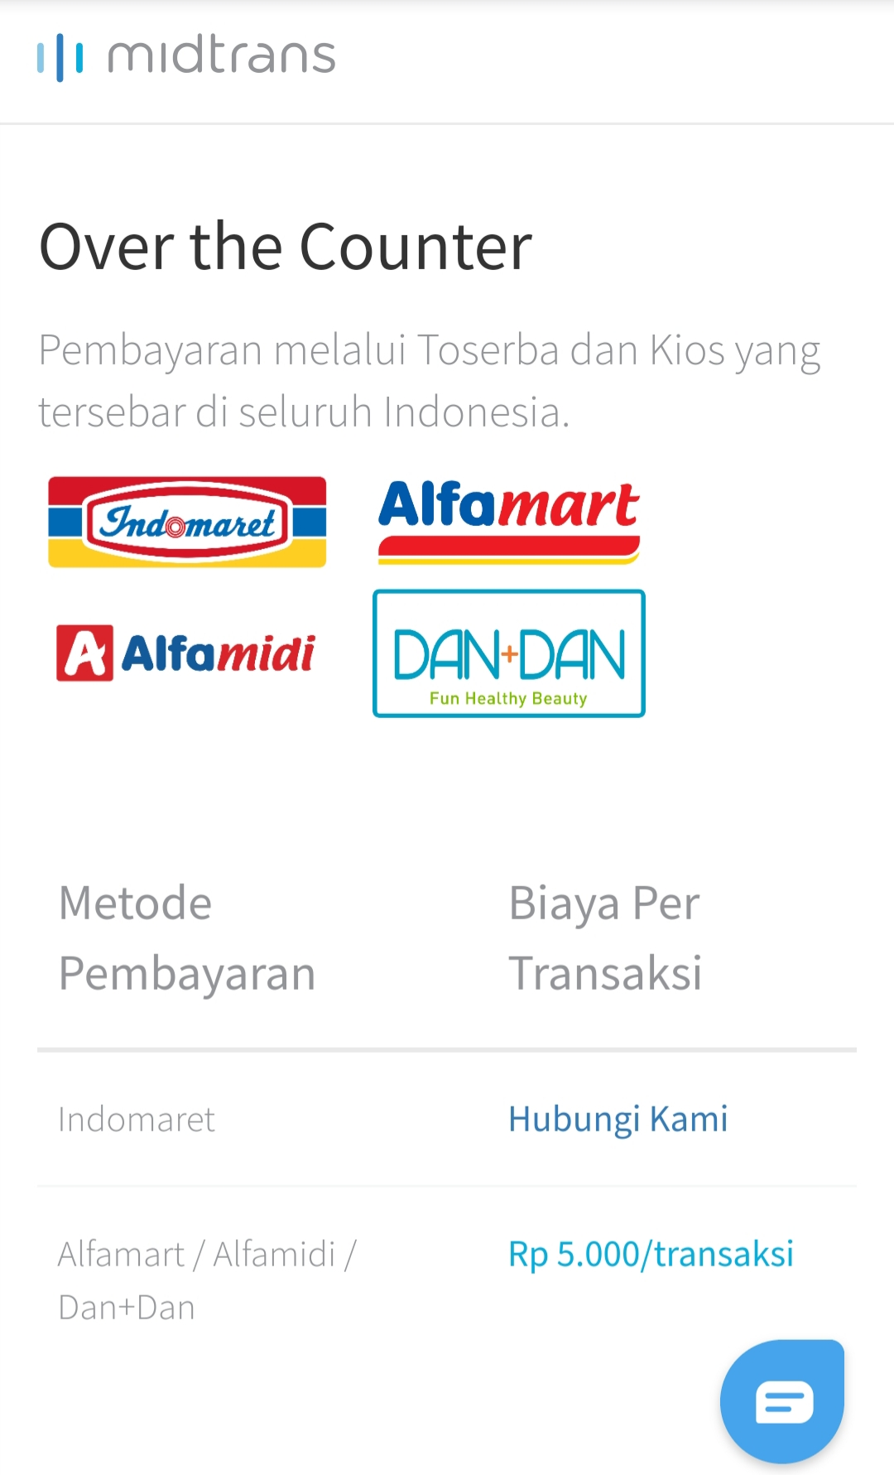
Midtrans

Slide 10
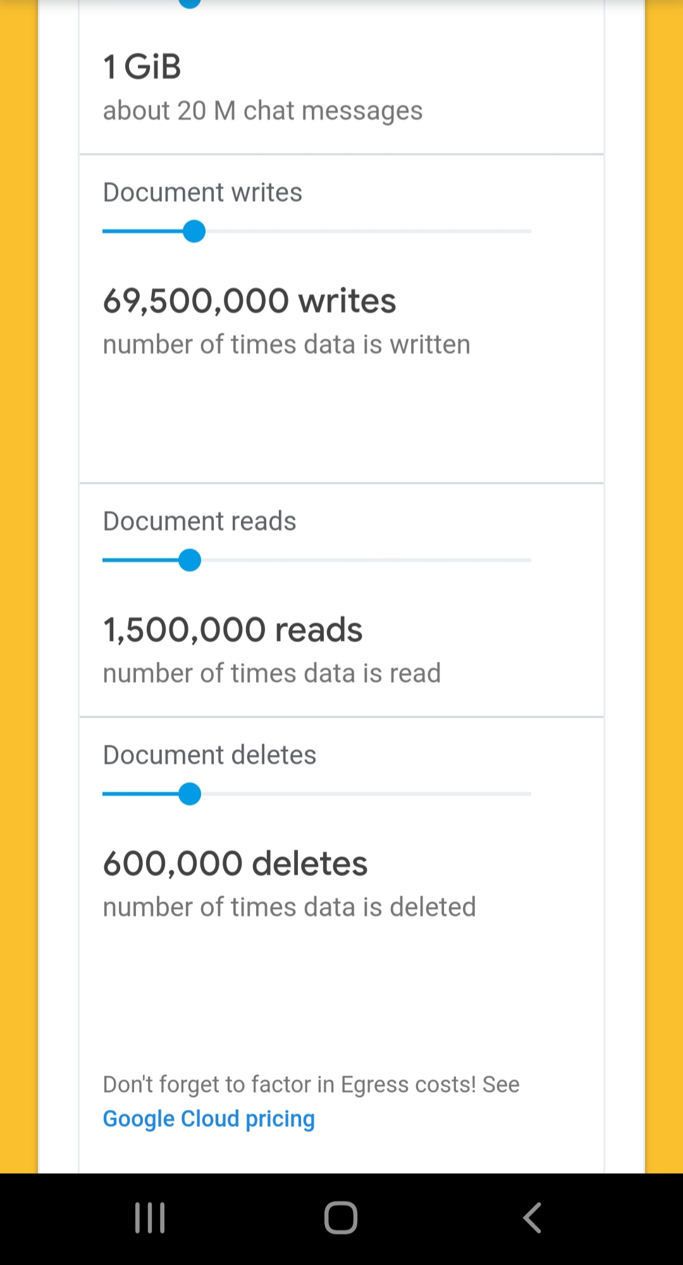
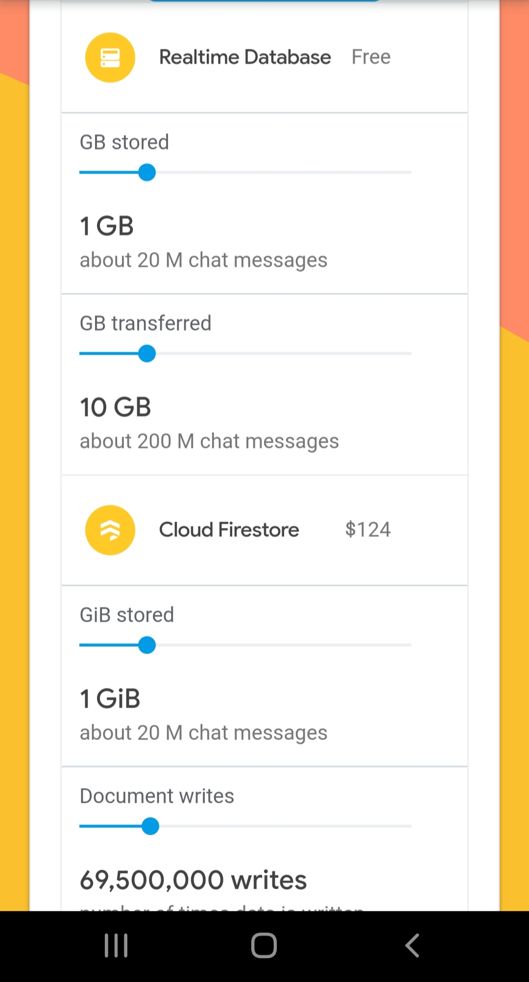
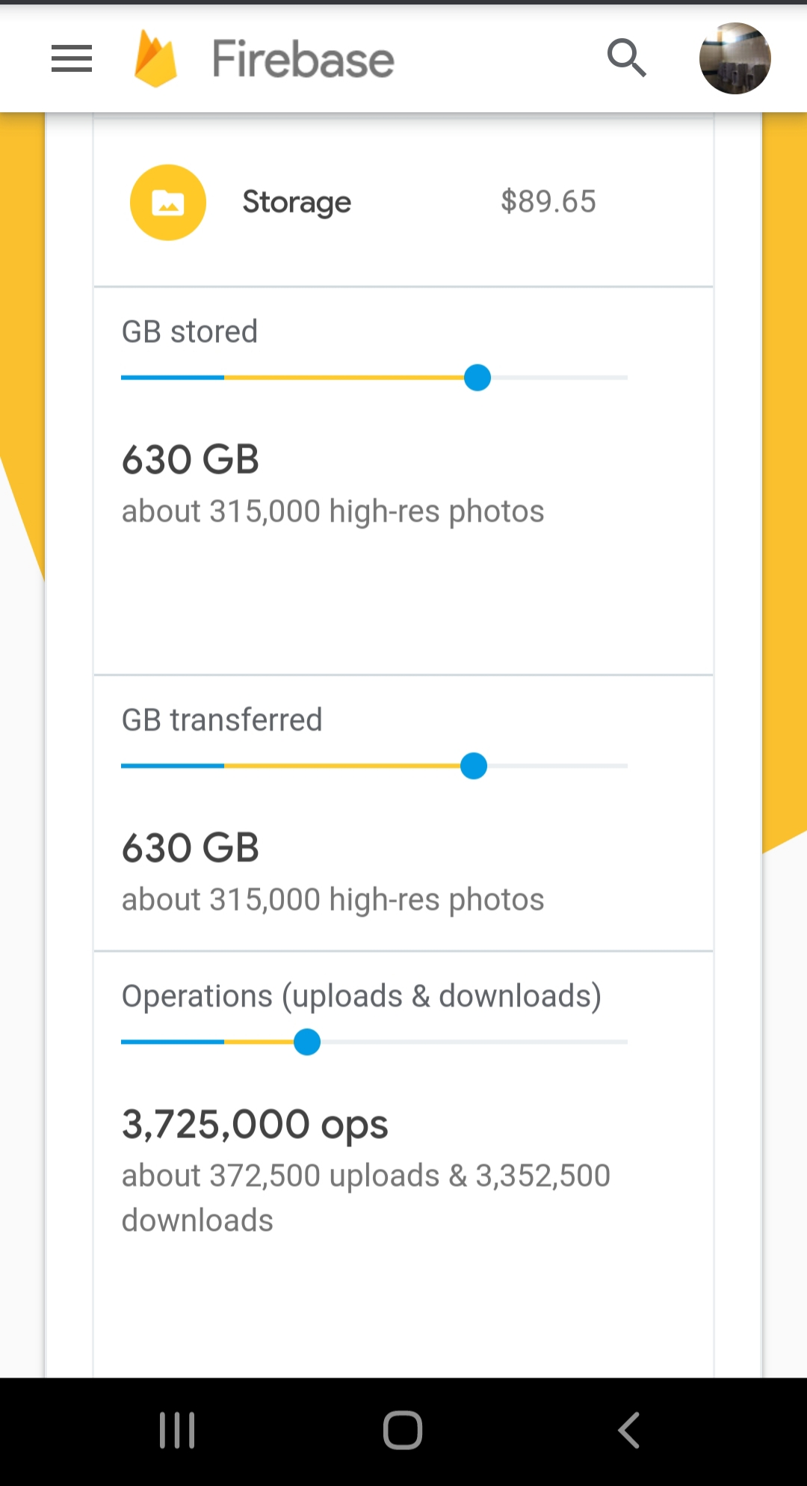

Slide 11
